Slide 1
Distributed Feature Engineering for GNN-based
Fraud Detection System
Group no. : 13
Guide : Prof. Dev Mukherjee

Slide 2
Introduction
Motivation
Solution
Fail to capture relational and temporal patterns in growing digital transaction volumes
Graph Neural Networks (GNNs) can effectively model user-transaction relationships to identify fraudulent behavior

Slide 3
Project Objective
Graph Based Analysis
Detect coordinated fraud networks through graph relationship analysis
Distributed Feature Engineering
Implement distributed architecture with containerized Feature Engineering
Better Fraud Detection
Transform fraud detection from transaction-based to network-aware prevention
Efficient Parallel Processing
Create scalable container orchestration for parallel graph processing

Slide 4
Technologies Required
Core Technologies
Data Processing
Python, FastAPI, TensorFlow,
Parquet, Pandas/NumPy NetworkX
Distributed Architecture
GNN & Fraud Model
Docker, Kubernetes, Kafka , Zookeeper
PyTorch, DGL, GraphSAGE/GCN

Slide 5
Literature Survey
Financial fraud detection using graph neural networks: A systematic review
Author: Soroor Motie, Bijan Raahemi
First systematic literature review exploring GNNs for financial fraud detection, identifies research gaps in unsupervised approaches
"Graph neural networks for financial fraud detection: a review" (2024-2025)
Author: Dawei Cheng, Yao Zou, Sheng Xiang & Changjun Jiang
Most recent comprehensive review revealing GNNs effectiveness in capturing complex relational patterns
"Financial fraud detection through the application of machine learning techniques: a literature review" (2024)
Author: Ludivia Hernandez Aros, Luisa Ximena Bustamante Molano
This article conducts a comprehensive literature review of machine learning (ML) approaches used to detect financial fraud, aiming to map out key contributors, methodologies, fraud types, datasets, and evaluation metrics across the field

Slide 6
Project Summary
Graph Neural Network Fraud Detection: Transaction data → graph conversion → GNN classification with >90% precision target
Distributed Full Graph Replication: Each container gets complete compressed graph copy for simplified training without partitioning complexity
Complete ML Pipeline: Data preprocessing → graph construction → distributed training → feature storage → REST API inference
Production Deployment: Docker containerization, Redis storage, scalability to 1M+ nodes with <100ms latency
Tech Stack: PyTorch + DGL + FastAPI + Docker for enterprise-ready fraud detection system

Slide 7
Expected Flow Chart
Distributed F. E.
Sending requests to containers with graph and features
Graph Construction
Nodes and Edge creation and graph storage
Data processing
Evaluation & Inference
Data gathering from different sources and processing
Combining features and evaluating the fraudulence
Feature Extraction
Feature extraction from calculated features

Slide 8
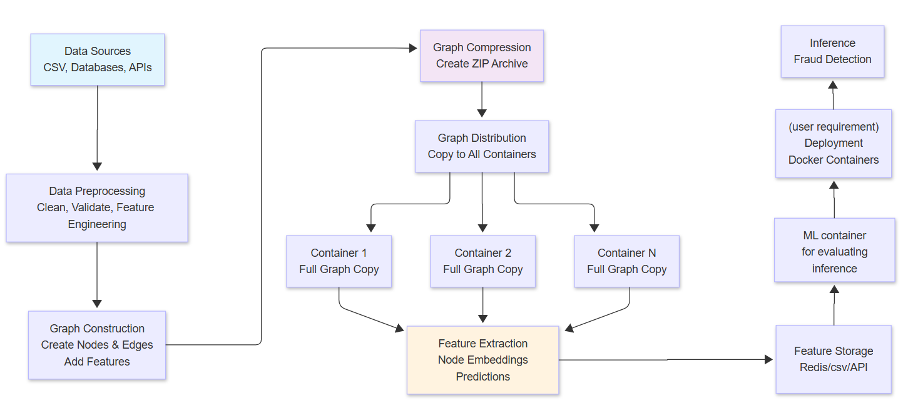
Project Flow

Slide 9
Expected Outcome
Scalable Graph-based Fraud Detection System
Distributed Processing Framework
Enhanced Detection Accuracy
Feature Storage and Retrieval System
Comprehensive Feature Engineering Pipeline
End-to-End Automated Pipeline

Slide 10
Implementation Timeline
Week 1-2
Week 3-4
Requirements analysis, Data preprocessing and graph construction modules
Distributed system architecture design GNN model implementation
01
02
03
04
Week 5-6
Week 7-8
Full graph replication and compression system Distributed training with gradient synchronization Feature storage backend and API development
Docker containerization and deployment scripts System performance optimization and testing

Slide 11
References
Motie, S., & Raahemi, B. (2024). Financial fraud detection using graph neural networks: A systematic review. Expert Systems with Applications, 240, Article 122156. https://doi.org/10.1016/j.eswa.2023.122156
Cheng, D., Zou, Y., Xiang, S., & Jiang, C. (2025). Graph neural networks for financial fraud detection: A review. Frontiers of Computer Science, 19(article number 199609). https://doi.org/10.1007/s11704-024-40474-y
Hernandez Aros, L., Bustamante Molano, L. X., Gutierrez-Portela, F., Moreno Hernandez, J. J., & Rodríguez Barrero, M. S. (2024). Financial fraud detection through the application of machine learning techniques: A literature review. Humanities and Social Sciences Communications, 11, Article 1060. https://doi.org/10.1057/s41599-024-03606-0

Slide 12
Thank You

Slide 13
Data migration process infographics
Neptune
Jupiter
Neptune is the farthest planet from the Sun
It’s the biggest planet in the Solar System
Venus
Saturn
It’s terribly hot, even hotter than Mercury
Saturn is the ringed planet and a gas giant
Mercury
Mars
Mercury is the closest planet to the Sun
Despite being red, Mars is a cold place
The Sun
The Moon
It’s the star at the center of the Solar System
The Moon is Earth’s only natural satellite

Slide 14
Data migration process infographics
Neptune
Venus
Mercury
It’s the farthest planet from the Sun
It’s terribly hot, even hotter than Mercury
Mercury is the closest planet to the Sun
Solar System
Jupiter
Saturn
Mars
It’s the biggest planet in the Solar System
Saturn is the ringed planet and a gas giant
Despite being red, Mars is a cold place

Slide 15
Data migration process infographics
Neptune
Jupiter
Mars
Neptune is the farthest planet from the Sun
Jupiter is the biggest planet in the Solar System
Despite being red, Mars is a cold place, not hot
Mercury

Slide 16
Data migration process infographics
Jupiter
Neptune
Jupiter is a gas giant and the biggest planet in the Solar System
Neptune is the farthest planet from the Sun. It’s really cold there
Saturn
Mercury
Saturn is a gas giant with rings. It’s composed of hydrogen and helium
Mercury is the closest planet to the Sun and the smallest one

Slide 17
Data migration process infographics
1
7
8
8
Neptune
1
Jupiter
Neptune is the farthest planet from the Sun
It’s the biggest planet in the Solar System
2
6
7
3
5
Venus
4
Saturn
It’s terribly hot, even hotter than Mercury
Saturn is a gas giant with several rings
2
3
4
5
6
Mercury
Ceres
Mars
Earth
Mercury is the closest planet to the Sun
Ceres is located in the main asteroid belt
Despite being red, Mars is a cold place
Earth is the beautiful planet where we all live

Slide 18
Data migration process infographics
01
03
Jupiter
Saturn
Jupiter is a gas giant and the biggest planet in the Solar System
Saturn has several rings. It’s composed of hydrogen and helium
02
04
Mars
Venus
Despite being red, Mars is actually a very cold place
Venus has a beautiful name and is the second planet from the Sun

Slide 19
Data migration process infographics
45%
Mercury
It’s the closest planet to the Sun and the smallest one in the Solar System—it’s only a bit larger than the Moon
55%
Venus
Venus has a beautiful name and is the second planet from the Sun. It’s terribly hot, even hotter than Mercury

Slide 20
Data migration process infographics
Neptune
Jupiter
Venus
Neptune is the farthest planet from the Sun
Is the biggest planet in the Solar System
Venus is terribly hot, even hotter than Mercury
Saturn
Earth
Mercury
Saturn is the ringed planet and a gas giant
Earth is the beautiful planet where we all live
Mercury is the closest planet to the Sun

Slide 21
Data migration process infographics
Jupiter
Neptune
Jupiter is a gas giant and the biggest planet in the Solar System
Neptune is the farthest planet from the Sun. It’s really cold there
Saturn
Mercury
Saturn is a gas giant. It’s composed of hydrogen and helium
Mercury is the closest planet to the Sun and the smallest one
Venus
Earth
Venus has a beautiful name and is the second planet from the Sun
Earth is the third planet from the Sun and where we all live

Slide 22
Data migration process infographics
Neptune
Jupiter
Neptune is the farthest planet from the Sun
It’s the biggest planet in the Solar System
Venus
Saturn
It’s terribly hot, even hotter than Mercury
Saturn is a gas giant with several rings
Mercury
Mars
Mercury is the closest planet to the Sun
Despite being red, Mars is a cold place

Slide 23
Data migration process infographics
Venus
Jupiter
Mercury
Venus has a beautiful name and is the second planet from the Sun
Jupiter is a gas giant and the biggest planet in the Solar System
Mercury is the closest planet to the Sun and the smallest one

Slide 24
Data migration process infographics
Ceres is located in the main asteroid belt
Neptune is the farthest planet from the Sun
Venus is the second planet from the Sun
Mercury is the closest planet to the Sun
Planning
Data backup
Execution
Post-mig audit
Data profiling
Migration design
Testing
Jupiter is the biggest planet of them all
Despite being red, Mars is a cold place
Saturn is the ringed planet and a gas giant

Slide 25
Data migration process infographics
Introduction of an additional system
Shift to a centralized base
Ceres is located in the main asteroid belt
Despite being red, Mars is a cold place
Storage capacity expansion
Moving data to the cloud
Mercury is the closest planet to the Sun
Neptune is the farthest planet from the Sun
Legacy system modernization
Mergers and acquisitions
Venus is the second planet from the Sun
Saturn is the ringed planet and a gas giant
Historical data
Jupiter is the biggest planet of them all

Slide 26
Data migration process infographics
Storage migration: between physical media
Data center migration: between location/servers
Database migration: between DBMSs
Business process migration: Between infrastructures
Application migration: between platforms
Cloud migration: from on-prem/cloud to cloud

Slide 27
Data migration process infographics
Mars
Mercury
Despite being red, Mars is a cold place. The planet is full of iron oxide dust
It’s the closest planet to the Sun and the smallest one in the Solar System
Saturn
Venus
Saturn is a gas giant with rings. It’s composed of hydrogen and helium
Venus has a beautiful name and is the second planet from the Sun

Slide 28
Data migration process infographics
Neptune
Jupiter
Neptune is the farthest planet from the Sun
25%
40%
It’s the biggest planet in the Solar System
Venus
Saturn
It’s terribly hot, even hotter than Mercury
70%
85%
Saturn is the ringed planet and a gas giant

Slide 29
Data migration process infographics
Data
From
To
Data volume
Mars | Admin system 1 | Cloud service 1 | 1.8 GB
Mercury | Admin system 2 | Cloud service 2 | 25.4 GB
Jupiter | Admin system 3 | Cloud service 3 | 12.8 GB
Saturn | Admin system 4 | Cloud service 4 | 59,.1 GB
Venus | Admin system 5 | Cloud service 5 | 2.9 GB

Slide 30
Data migration process infographics
Jupiter
Neptune
Jupiter is a gas giant and the biggest planet in the Solar System
Neptune is the farthest planet from the Sun. It’s really cold there
Saturn
Mercury
Saturn is a gas giant with ring. It’s composed of hydrogen and helium
Mercury is the closest planet to the Sun and the smallest one

Slide 31
Data migration process infographics
Process
Description
Risk
Phase 1 | Despite being red, Mars is a cold place
Phase 2 | Mercury is the closest planet to the Sun
Phase 3 | Neptune is the farthest planet from the Sun
Phase 4 | Saturn is the ringed planet and a gas giant
Phase 5 | Venus is terribly hot, even hotter than Mercury

Slide 32
Data migration process infographics
35%
55%
80%
Neptune
Mercury
Jupiter
Neptune is the farthest planet from the Sun. It’s really cold there
Mercury is the closest planet to the Sun and the smallest one
Jupiter is a gas giant and the biggest planet in the Solar System

Slide 33
Data migration process infographics
Neptune
Neptune is the farthest planet from the Sun
Jupiter
Mars
Jupiter is the biggest planet in the Solar System
Despite being red, Mars is a cold place, not hot
Venus
Venus is terribly hot, even hotter than Mercury

Slide 34
Data migration process infographics
Neptune
Jupiter
Neptune is the farthest planet from the Sun
It’s the biggest planet in the Solar System
Venus
Saturn
It’s terribly hot, even hotter than Mercury
Saturn is the ringed planet and a gas giant
Mercury
Mars
Mercury is the closest planet to the Sun
Despite being red, Mars is a cold place

Slide 35
Data migration process infographics
Jupiter
Saturn
Mercury
Venus
60%
19%
12%
9%
Jupiter is a gas giant and the biggest planet in the Solar System
It’s the ringed planet. It’s a gas giant, composed mostly of hydrogen
It’s the closest planet to the Sun and the smallest one of them all
Venus has a beautiful name and is the second planet from the Sun

